Slide 1
Performance Workstream
Performance Characterisation: Progress Assessment
James Bush, Vijay Kumar, Warren Carew

Slide 2
Workstream Update
Workstream Name: | Performance Characterisation (github repo)
Roadmap Pillars: | Make Adoption Easier / Foundation: Quality Product
Lead: | James Bush
Workstream Objectives: | To bring the costs of transactions as close to zero as possible by: reducing TCO, and ability to start small and scale as traffic increases By improving overall system efficiency See detailed breakdown in following slides
Progress Against Objectives: | Characterisation and first pass of optimisations completed for Discovery phase Agreement phase Transfers phase All optimisations are part of pending release (Acacia) Follow-up optimisations against all phases scheduled for next PI Bare metal testing has begun
Support Needed: | Engineers with infra and/or mojaloop core experience. Bare metal testing support.

Slide 3
Workstream Objectives
Q: What problem(s) are we trying to solve?
A: Understand how various components of the system perform individually and collectively on hardware representative of near-term upcoming deployments. What are the system sensitivities to hardware characteristics and scheme architecture (number of transacting participants etc…).
Strategy: Show the system is capable of 1000 tps .
Plan: Discover what the actual number is and push beyond current limits.
Priority 1: Find out how fast the system is.
If it doesn’t meet the baseline, then take immediate action to rectify.
Target is 1000 tps sustained for 1 hour, < 1% taking > 1 second @ 0% unexpected errors, and durable for 1 hour.
A “transaction” is: an address lookup followed by a quote followed by a transfer.
Consider ramp-up.

Slide 4
Workstream Objectives
Cont…
Nation scale deployment is the target customer right now (adoption pipeline); target activities at understanding performance characteristics for this type of deployment.
Design appropriate scheme architecture(s) to simulate.
Firstly, target national scale switch situations with many DFSPs. (? how many, some big, some small ?)
Design appropriate REUSABLE test architecture and tools e.g. simulators, load generators etc… (keep loads separate i.e. sims on separate infra to switch components)
Run this in an environment where we can take underlying platform considerations out of the equation e.g. bare metal; that accurately represents the targeted deployment environment. (simplify)
Tests should be end-to-end:
What does this mean? ALS? Quote? Transfer?
It means all three stages! BUT - we have to account for user interface delays, e.g. latency at each end due to test harness latency etc…
Consider looking at the same toolchain as used previously for generating load (jMeter clusters).
Try to figure out how to handle callbacks in jMeter to keep the amount of “stuff” in the test harnesses to a minimum.
Design appropriate loads/transaction scenario mix (+ve, -ve cases etc…) to test the edges of the system. Include scheme level issues such as liquidity problems etc…
Include some scenarios which test failure modes for certain situations e.g. DFSP goes down, slows down etc… capture the impact of such events on the system as a whole.
How about running settlements during periods of high load?
Push beyond stable limits to discover failure modes and plan any remediating actions needed.
Decide/Design appropriate metrics and points of observation to capture and monitor data for analysis.
Not just application layer metrics, also look at underlying infra metrics, CPU, I/O etc…
Consider how to best inform calculations of cost per transfer, TCO vs procurement costs, maintenance etc... Provide data to support those calculations.

Slide 5
Workstream Objectives
Cont…
Priority 2: Introduce performance tests at a lower (?component) level in CI pipelines
Run these tests in CI runners on merge/commit/PR?
CI runners are on shared infra, this might not be good for comparison.
Possibly run these on foundation infra, possibly have some private CI runners in foundation AWS account?
Generate metrics, reports, charts etc… so all interested parties can see the impact of code changes on performance.
Priority 3: Develop capacity to manually run repeatable full system end-to-end performance tests (as per P1 above):
Spin up / down an entire env and test infrastructure, run tests, capture metrics, generate reports.
Analyse the cost of doing this.

Slide 6
Approach
Previous performance analysis confirmed the transfer phase could operate at 1000 tps.
Going forward we want to be able to baseline performance at each release in an automated way.
The approach is iterative, incremental, time boxed, targeting
Performance characterization by phase Discovery, Agreements, Transfers and E2E
First pass optimisation to improve efficient so that it can run on reasonable hardware
Repeatable characterisation tools

Slide 7
Reusable
Operations per second [OP/s]
Complete functional request from Payer to Payee with Callback response from Payee to Payer
System Phase(s) Under Test
K6
Sim
DFSP Load Generator
DFSP Performance Simulator
Phase Under Test
Discovery Only
Agreement Only
Transfer Only
E2E-Discovery-Agreement-Transfer
Mojaloop Core Test Harness

Slide 8
Performance Baseline
Isolated Phases on Single HW node
Test Case | PI-21 Performance | PI-22 Performance
Discovery (parties) | 10 OP/s | 100 OP/s 4 instances = 420 OP/s Further optimisations predict ~400 OP/s per instance
Agreement (quotes) | 73 OP/s | 177 OP/s 2 instances = ????
Transfers (transfers) | 95 OP/s Throttled by position handler, so focused here | 233 OP/s 1 instance of position handler (with batching) Other central services scaled to 4 instances Supporting api services scaled to 2 instances
* Run on single hardware instance (m6i.4xlarge) with Load and SUT on single container for CI/CD
* OP/s - Complete functional request from Payer to Payee with Callback response from Payee to Payer

Slide 9
E2E Baseline
To
provide ongoing performance characterisation capability
and
support the “start small” approach:
E2E - Discovery Agreement and Transfers
Single HW node (16 core / 128GB / 2TB)
Load generation and SUT on same node
~220 Financial TPS
Notes:
This was running out of HW capacity 80% CPU and load tools consuming more resources that limit further throughput

Slide 10
Step by Step Journey
Results available
In progress
Quotes
Discovery, Quotes and Transfers
Transfers
Discovery
Dependencies
Discovery, Quotes, Transfers & Mojaloop Connector
Handlers in Isolation
Scaling

Slide 11
Hosting progression
Results available
In progress
Scaling Nodes
Optimised scaled
K8s Environment
No security
Add Participation Support
Moving to Kubernetes
K8s Environment
No security
Including Mojaloop Connector (SDK)
In progress
Include Security
Docker Compose
Results available
IaC testing
With mTLS & JWS
Single Machine
Notes:
We have lo

Slide 12
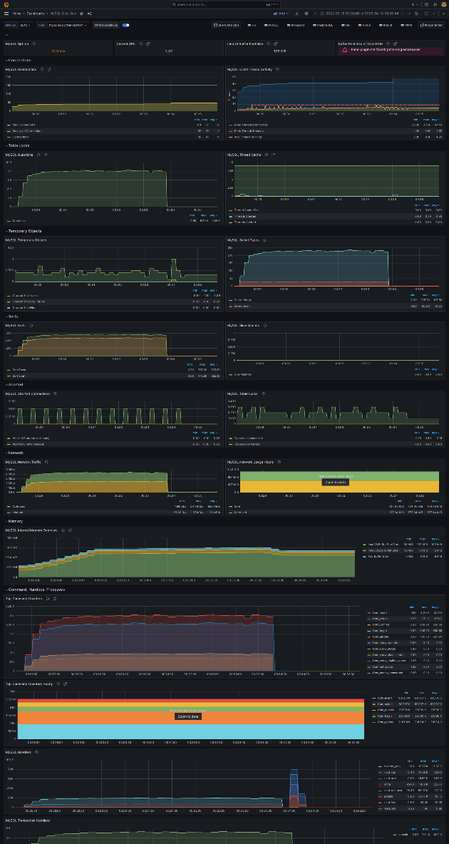
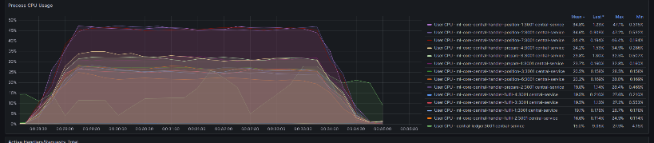
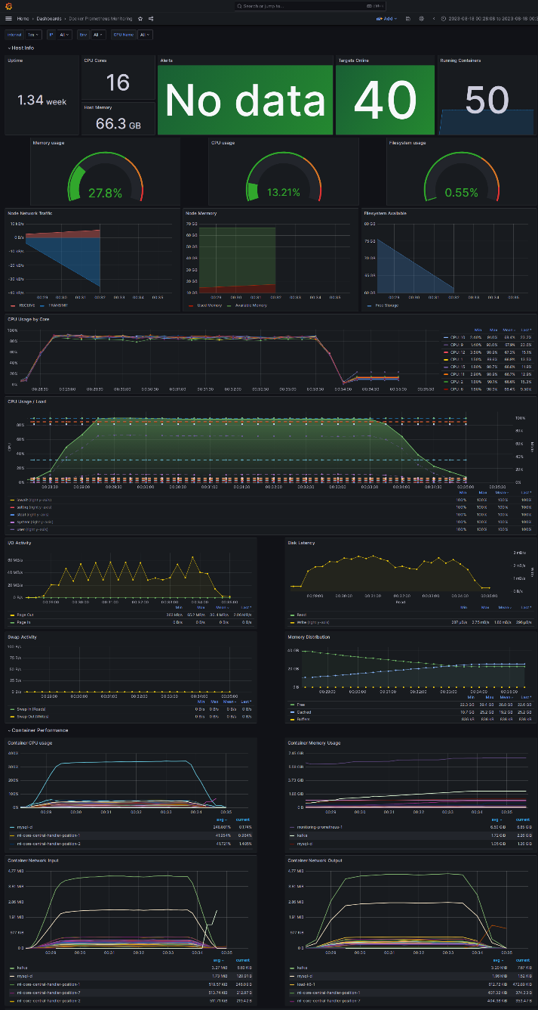
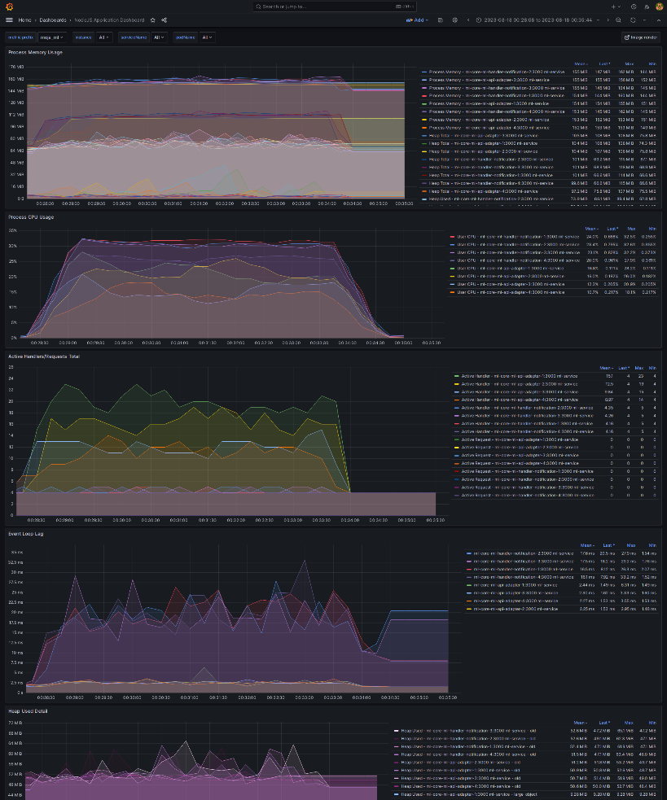
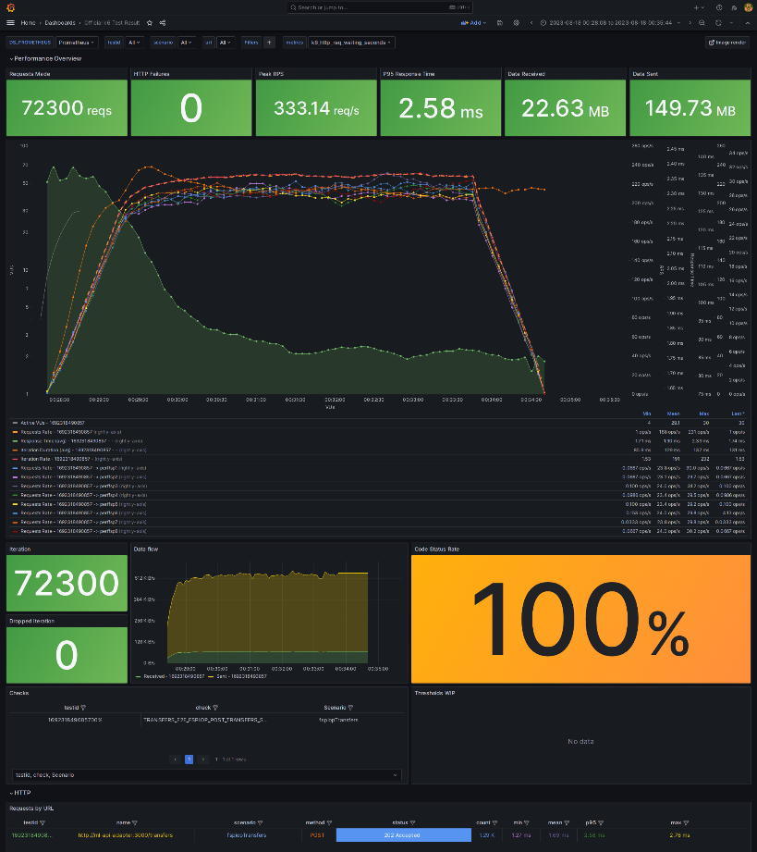
More metrics and grafana dashboards
New metric end points added.
Dashboards where added, updated and extended
Automated scripts to execute a test-scenario & capture results (screenshots)

Slide 13
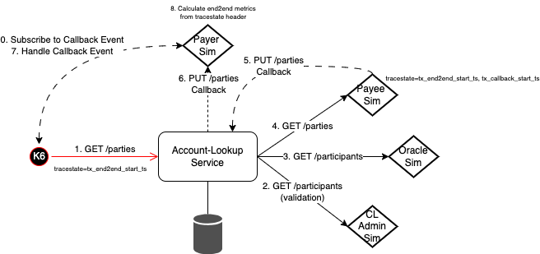
Discovery Phase (parties)

Slide 14
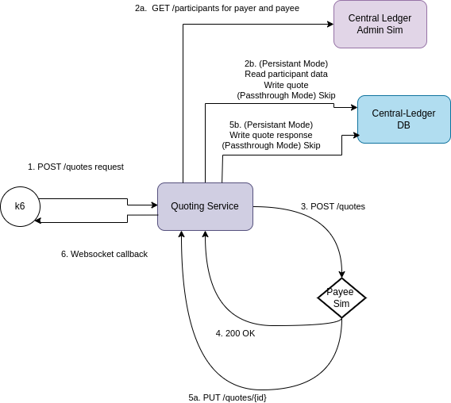
Agreement Phase (quotes)

Slide 15
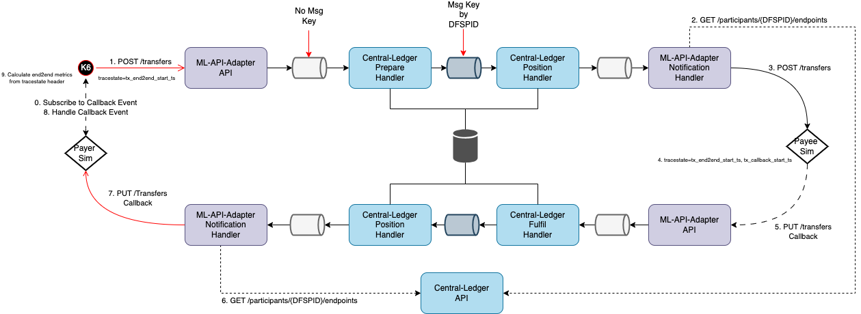
Transfer Phase (transfers)

Slide 16
End to end (E2E) - WIP
+
1. Discovery
(Parties)
2. Agreement
(Quotes)
+
3. Transfers

Slide 17
What Next…
Notes:
It won’t surprise anyone that considers the algorithm being implemented that the Position Handler is the constraint for transfers because we have to manage the Position for each DFSP

Slide 18
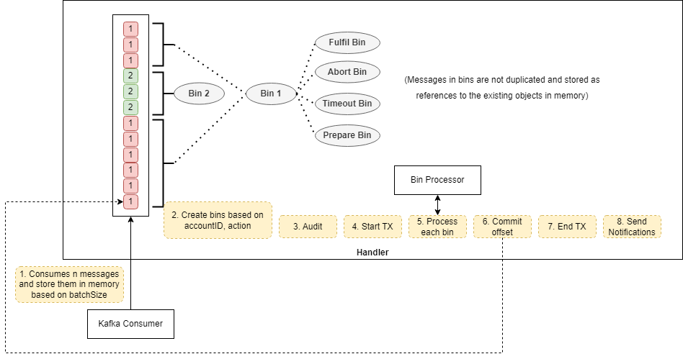
WIP - Transfers with Batching
Batching in the Position handler is now functional for prepare events.
Results look promising
New batching design:
Throughput | Latency
183 ops/s | 5.37ms | Without Batching
1.10K ops/s | 8.39ms | Batch Size: 10
2.22K ops/s | 36.3ms | Batch Size: 100
Position Handler - Prepare
Notes:
As presented at the DA, and happy to go into more details we are seeing

Slide 19
References
Tools and testing stack: https://github.com/mojaloop/ml-core-test-harness
Batching design and sequence diagrams: https://github.com/mojaloop/documentation/blob/feat/3488-enable-batch-processing/docs/technical/central-ledger/transfers/1.3.4-position-handler-consume-binning.md
Performance Characterization results, dashboards and documentation: https://github.com/mojaloop/ml-perf-characterization
PRs and releases:
https://github.com/mojaloop/helm/pull/582
https://github.com/mojaloop/central-ledger/pull/968
https://github.com/mojaloop/quoting-service/releases (15.1.0, 15.2.0, 15.2.1, 15.2.2, 15.3.0, 15.4.0)
https://github.com/mojaloop/account-lookup-service/releases (14.2.0, 14.2.1, 14.2.3)

Slide 20
Reach out to participate
Email: james.bush@mojaloop.io
Mojaloop Slack: #perf-scale-benchmarking

